Slide 1
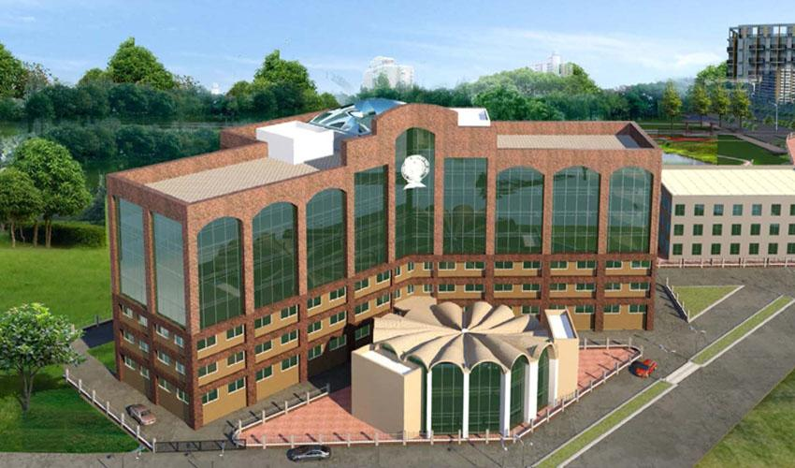
Q&A Session with Achievers Across Sectors

Slide 2
On November 9, 2024, the Placement Cell at the International Institute for Population Sciences (IIPS) organized an engaging online panel discussion titled "Q&A Session with Achievers Across Sectors." The event, held at 10 a.m., brought together alumni from the 2018-2020 batch who have successfully carved out careers in diverse sectors. Moderated by Mayur Mishra, Final-year MBD student and Placement Cell representative, the session provided a valuable platform for interaction between the alumni and around 40 students from various cohorts, including MBD first and second years and MSD first years. Placement Officer Nalini formally welcomed the panelists and attendees.

Slide 3
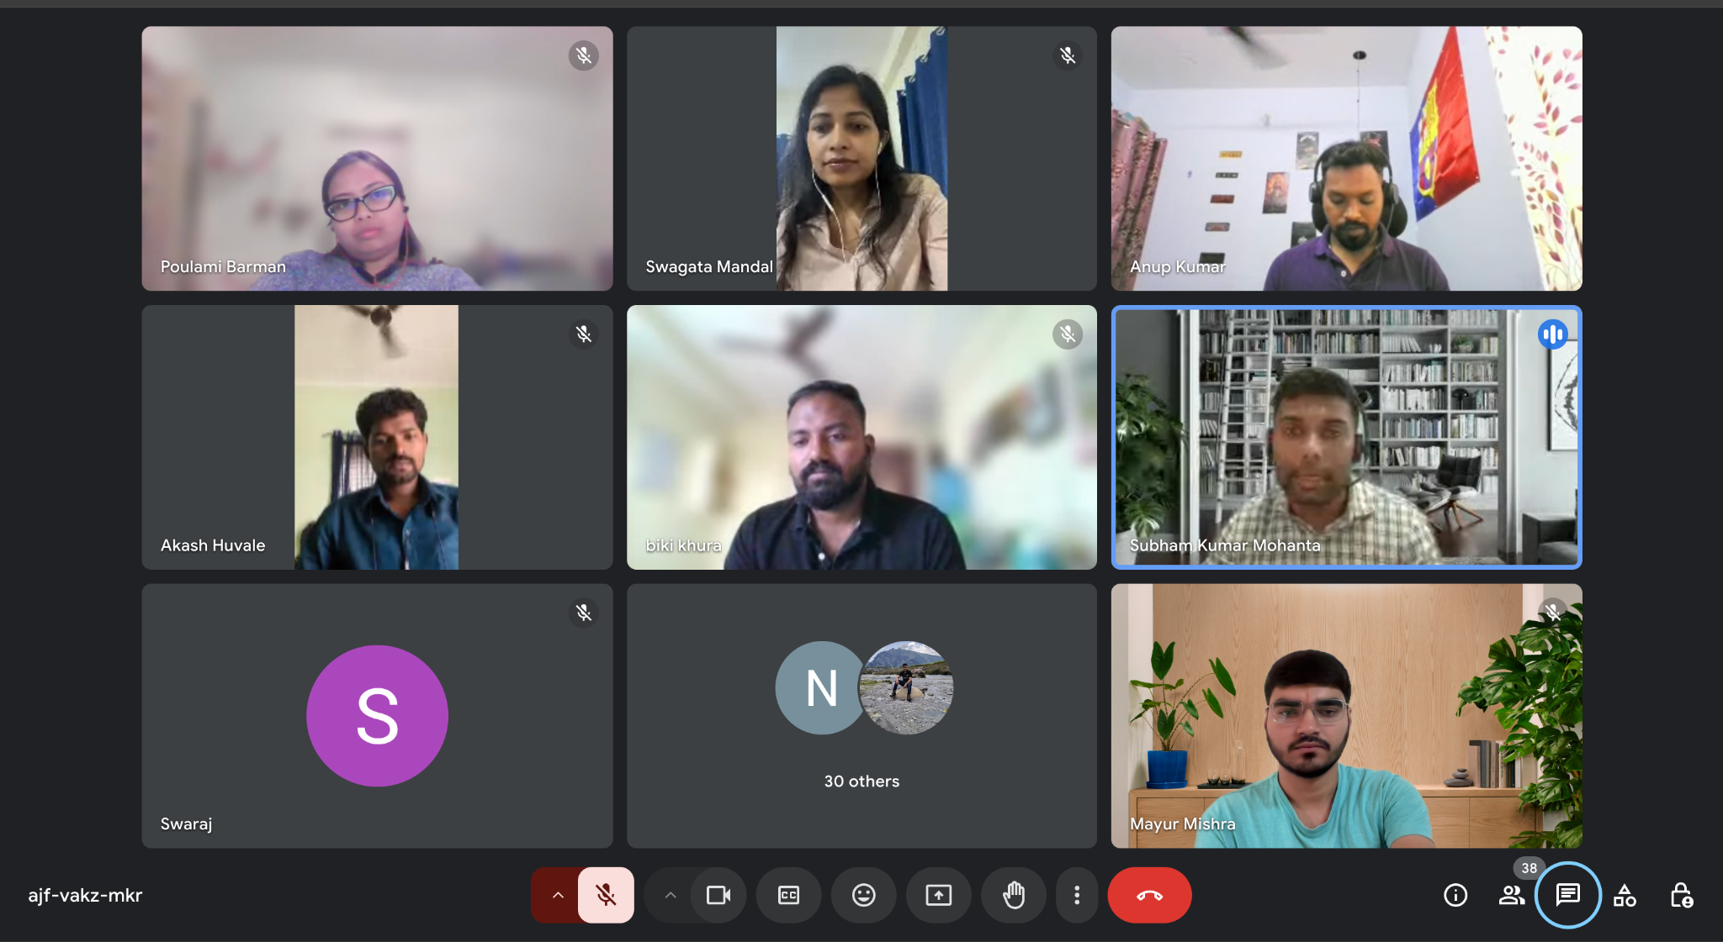

Slide 4
Panelists and Their Roles
The esteemed panel consisted of alumni currently working in public health, government, academia, and the pharmaceutical/CRO sector. Representing different domains, these professionals shared their experiences, advice, and career insights with the attendees:
Swagata Mandal and Subham Kumar Mohanta from the biostatistics roles at BMS, provided in-depth explanations about the biostatistics job role in the pharma industry. They discussed the types of projects they handle, the significance of statistical tools, and the specific applications of their work in clinical trials and drug development. This detailed insight into biostatistics was particularly helpful for students aiming to enter similar roles.
Anup Kumar, who now works at Novartis, shared his inspiring journey from a background in public health to a career in the pharmaceutical industry. He spoke about how his expertise in statistics played a pivotal role in securing his desired position. Anup also explored alternative paths to enter the pharma sector beyond biostatistics and statistical programming, offering a broader perspective for students considering various roles within the industry.

Slide 5
3. Sayeef (NTNU) and Poulami Barman (University of Rostock, Germany), both pursuing PhDs, guided students on how to approach and secure PhD opportunities abroad. They shared personal experiences, highlighting the “dos and don’ts” of the application process, essential networking tips, and the academic standards expected by international institutions. Poulami further extended her support, offering to provide guidance to any juniors interested in following a similar path.
4. Bikash Khura from MSI Reproductive Choices, who served as a session coordinator, played a key role in maintaining a relaxed and encouraging atmosphere throughout the discussion. He shared his advice on the importance of patience and hard work, emphasizing the need to focus on the Master’s dissertation as a foundation for research careers. He also recommended that students master one software tool during this process to improve their analytical skills.
5. Akash Shivaji Huvale from the Public Health Department, Government of Maharashtra, discussed various pathways into the government sector for statisticians and officers. He highlighted the qualifications required for such roles, the examinations and processes involved, and the types of positions available within government health programs. Akash’s guidance was invaluable for students interested in public service roles, particularly those looking to apply their statistical skills in policy analysis and health program management.

Slide 7
Key Takeaways from the Panel Discussion
The session was highly interactive, allowing students to ask questions and receive personalized guidance from alumni who were once in their shoes. Here are some key takeaways:
Biostatistics and Pharma Careers: Swagata and Subham’s detailed explanation of biostatistics roles gave students a clear understanding of job responsibilities, necessary technical skills, and the impact of biostatisticians in the pharmaceutical industry.
Pathways into the Pharmaceutical Sector: Anup Kumar's journey emphasized the flexibility of statistics and its applications beyond traditional roles, inspiring students to explore diverse paths within the industry.
Pursuing Foreign PhDs: Sayeef and Poulami’s insights on PhD opportunities were invaluable for students aspiring to study abroad. Their advice on application strategies, academic preparation, and networking offered students practical steps toward their academic goals.

Slide 8
Importance of Dissertation and Skill Mastery: Bikash highlighted the significance of the Master’s dissertation, advising students to treat it as a crucial learning experience. He also stressed the importance of becoming proficient in at least one analytical tool, which could enhance their employability and research potential.
Entering Government as a Statistician: Akash Shivaji Huvale’s insights into government roles were particularly beneficial for students aspiring to enter public service. He explained the exam pathways, eligibility criteria, and skills needed to succeed in government positions, offering students a realistic roadmap to pursuing a career in public health and policy analysis.

Slide 9
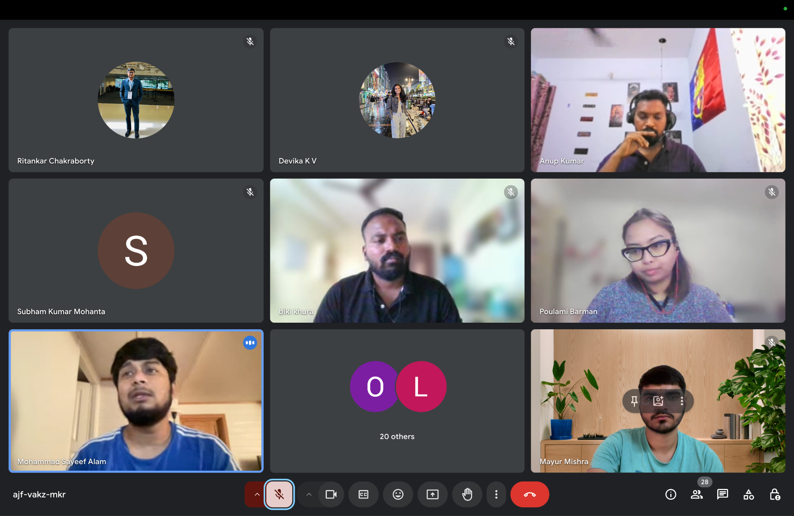

Slide 10
Conclusion
The panel discussion was a resounding success, fostering an informal yet insightful interaction between juniors and their accomplished seniors. The event not only demystified various career paths but also provided practical guidance tailored to students' immediate academic and career aspirations. The Placement Cell's initiative, received positive feedback from attendees, who left with a clearer understanding of their potential career trajectories and the steps needed to achieve their goals.
This event underscored the value of alumni mentorship, showing how experience sharing can bridge the gap between academic learning and real-world application. The Placement Cell at IIPS continues to play a vital role in supporting students as they navigate their professional journeys, equipping them with the knowledge and inspiration needed to excel in their chosen fields.

